Slide 1


SMART INDIA HACKATHON 2025
Problem Statement ID – SIH25110
Problem Statement Title - Palm Vein Biometric Voting System
Theme- Blockchain & Cybersecurity
PS Category- Software/Hardware
Team ID-
Team Name - Cybo-krypters

Slide 2
IDEA TITLE
Cybo-krypters
Proposed Solution
This project offers a palm vein biometric voting system that uses infrared cameras and LED lights to capture unique vein patterns in the palm. It replaces less reliable methods like fingerprints or smartcards with a hygienic, contactless, and secure biometric authentication.
The system addresses voting challenges by ensuring only eligible voters can access ballots, providing an easy-to-use voting interface with audio guidance for those with disabilities, and printing a paper receipt (VVPAT) for transparency.
Its innovative use of palm vein recognition for voting is unique at the student prototype level. It combines accessible design, secure logging using AES algorithm and QKD for encryption, and affordable hardware, making electronic voting safer, inclusive, and feasible for large-scale elections.

Slide 3
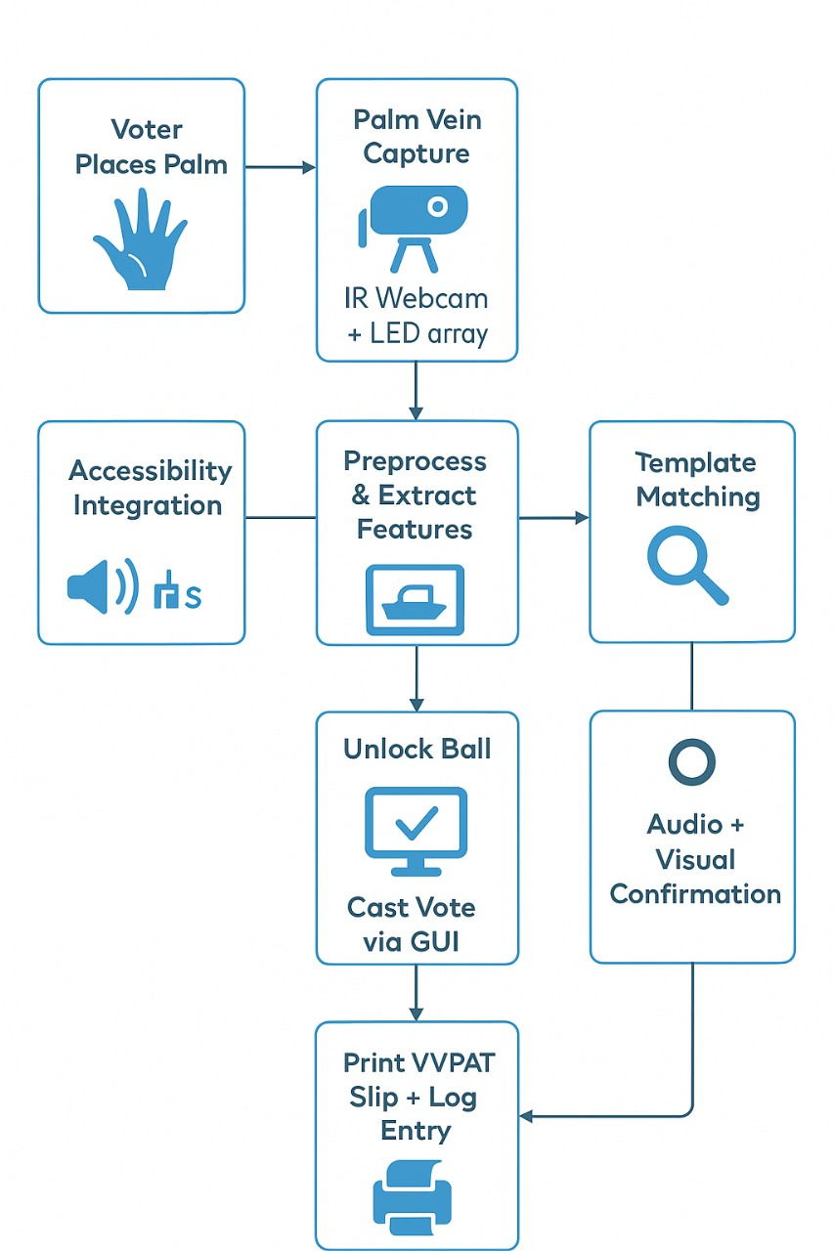
TECHNICAL APPROACH
Cybo-krypters
Technologies:
Language: Python, Java
Libraries/Frameworks: OpenCV ,
PyQt/Tkinter (GUI), PyCrypto , pyttsx3.
Database: Postgres
Hardware: Webcam, IR LED array, thermal printer.
Security: Quantum Key Distribution (QKD)
Methodology:
Capture palm vein images with IR webcam + LEDs
Preprocess and extract features using OpenCV
Match live data with encrypted templates in SQLite
On success, open voting interface with GUI + audio
Cast vote and print VVPAT slip
Record actions in secure, hash-chained log

Slide 4
FEASIBILITY AND VIABILITY
Cybo-krypters
Feasibility
Low-cost, available hardware (IR webcam, LEDs, printer)
Open-source libraries for fast development
Prototype tested with team palm images
Scalable beyond student-level demo
Viability
Image preprocessing & noise reduction
Encryption + secure template storage
Regular calibration, modular hardware
Audio guidance & simple interface
Hash-chained logs + VVPAT receipts

Slide 5
IMPACT AND BENEFITS
Cybo -krypters
🔮 Potential Impact
Secure, independent voting for elderly, disabled, visually impaired.
Prevents fraud & unauthorized voting with advanced biometrics + QKD-secured blockchain.
Enhances trust & transparency in democratic processes.
Provides scalable model for large-scale elections.
✅ Benefits of the Solution
Equity & Inclusion: Every voter gets equal & fair access.
Cost-Effective: Affordable hardware + open-source stack = reduced election expenses.
Tamper-Proof: Blockchain ledger + QKD = future-proof security.
Transparency: VVPAT + audit logs ensure verifiable election trail.
Innovation Catalyst: Opens scope for biometric verification in government services & schemes.
Academic Contribution: Demonstrates feasibility for student/hackathon innovation.

Slide 6
RESEARCH AND REFERENCES
Cybo-krypters
Review of palm vein recognition (IET Biometrics):
https://ietresearch.onlinelibrary.wiley.com/doi/10.1049/iet-bmt.2019.0034
An Open Source Contact-Free Palm Vein Recognition System:
https://ijaas.iaescore.com/index.php/IJAAS/article/view/9470
An extensive survey on finger and palm vein recognition (ScienceDirect):
https://www.sciencedirect.com/science/article/abs/pii/S2214785320366256
Palm Vein Technology by Aditya Bhargav Vankamamidi (SSRN):
https://papers.ssrn.com/sol3/papers.cfm?abstract_id=3908986
Voter-verified paper audit trail (Wikipedia):
https://en.wikipedia.org/wiki/Voter-verified_paper_audit_trail
A Study on Palm Vein Recognition Technologies (IRJET):
https://www.irjet.net/archives/V8/i10/IRJET-V8I10181.pdf

